Slide 1
BOOSTING ALGORITHM - REGRESSION
By,
Apoorva.E

Slide 2
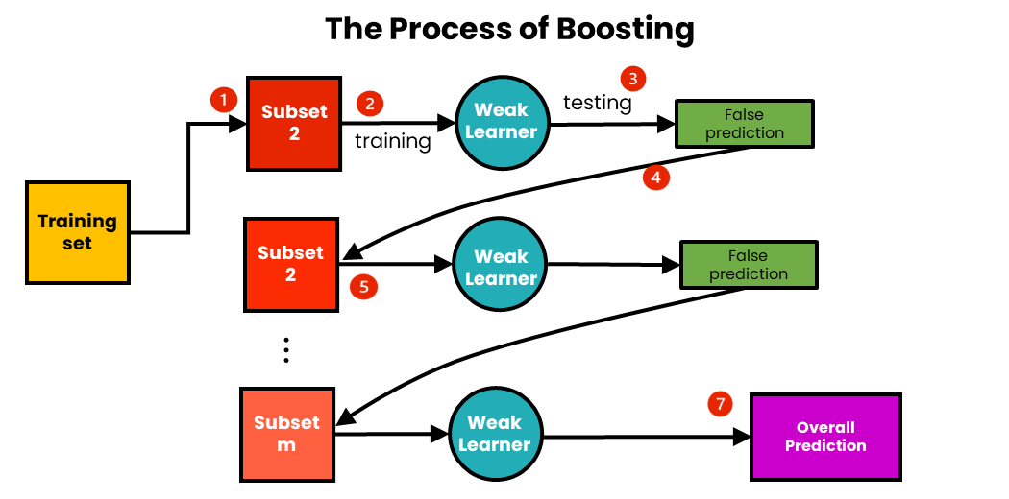
BOOSTING ALGORITHM
It is an ensemble method builds sequential tree models.
Every new model is trained to correct the errors from the previous model.
Improves overall model accuracy

Slide 3
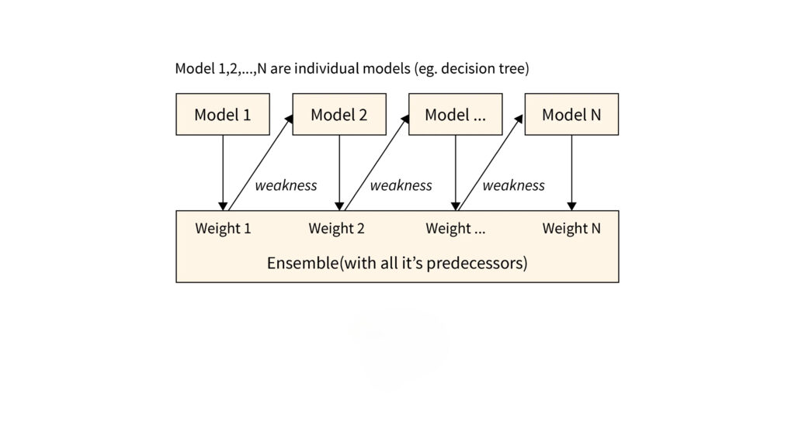
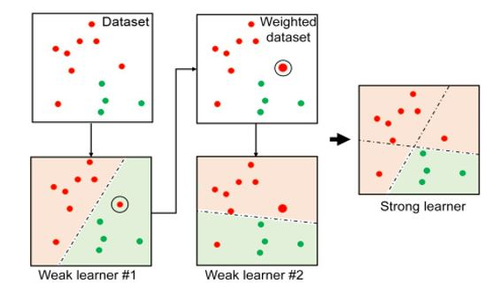
ADA BOOST – Adaptive boost
Ensemble learning.
Transform weak learners to strong learners.
Accuracy by giving incremental weight concept by reducing bais and variance.

